Slide 1
shortest paths
David Kauchak CS 140 – Spring 2023

Slide 2
Admin
Assignment 8
Assignment 9

Slide 3
All pairs shortest paths
All pairs shortest paths: calculate the shortest paths between all vertices
2
B
D
-1
1
3
-3
A
2
4
C
E
5

Slide 4
All pairs shortest paths
All pairs shortest paths: calculate the shortest paths between all vertices
Easy solution?

Slide 5
All pairs shortest paths
All pairs shortest paths: calculate the shortest paths between all vertices
Run Bellman-Ford from each vertex!
O(V²E)
Bellman-Ford: O(VE)
V calls, one for each vertex

Slide 6
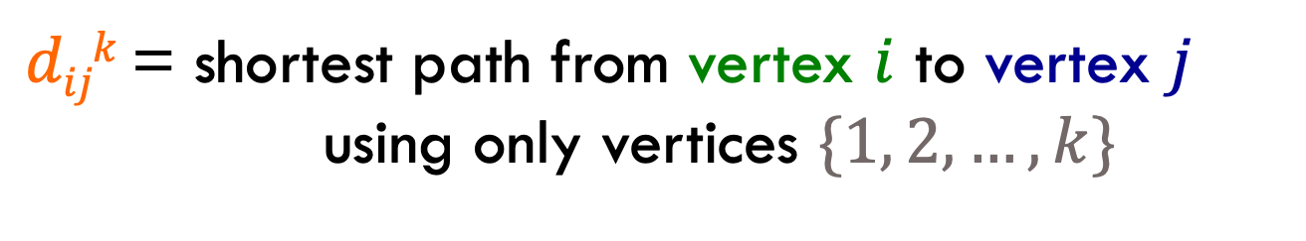
Floyd-Warshall: key idea
Label all vertices with a number from 1 to V
$dijk$ = shortest path from vertex $i$ to vertex $j$
using only vertices $\{1, 2, …, k\}$

Slide 7
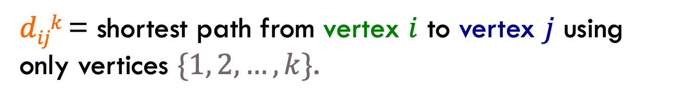
Floyd-Warshall: key idea
$dijk$ = shortest path from vertex $i$ to vertex $j$ using only vertices $\{1, 2, …, k\}$.
2
3
4
-1
1
3
-3
1
2
4
2
5
5
What is d₁₅³?

Slide 8
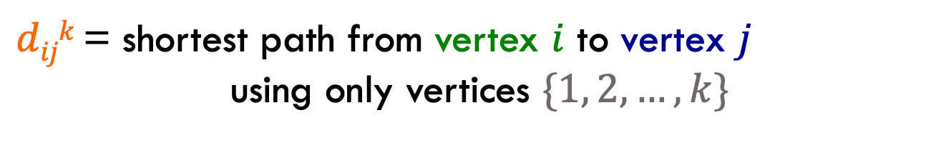
Floyd-Warshall: key idea
$dijk$ = shortest path from vertex $i$ to vertex $j$
using only vertices $\{1, 2, …, k\}$
2
3
4
-1
1
3
-3
1
2
4
2
5
5
d₁₅³ = 1. Can’t use vertex 4.

Slide 9

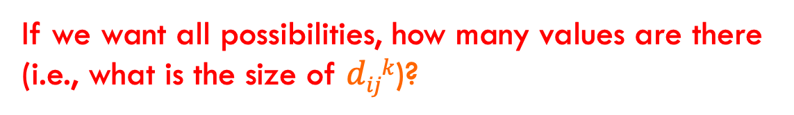
Floyd-Warshall: key idea
Label all vertices with a number from 1 to V
$dijk$ = shortest path from vertex $i$ to vertex $j$
using only vertices $\{1, 2, …, k\}$
If we want all possibilities, how many values are there (i.e., what is the size of $dijk$)?

Slide 10
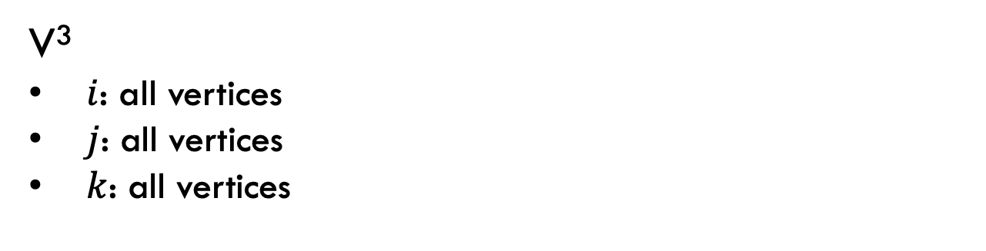
Floyd-Warshall: key idea
Label all vertices with a number from 1 to V
$dijk$ = shortest path from vertex $i$ to vertex $j$
using only vertices $\{1, 2, …, k\}$
V³
$i$: all vertices
$j$: all vertices
$k$: all vertices

Slide 11

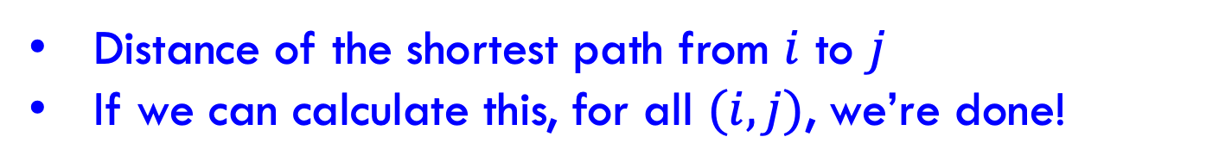
Floyd-Warshall: key idea
Label all vertices with a number from 1 to V
$dijk$ = shortest path from vertex $i$ to vertex $j$
using only vertices $\{1, 2, …, k\}$
What is $dijV$?
Distance of the shortest path from $i$ to $j$
If we can calculate this, for all $(i, j)$, we’re done!

Slide 12

Recursive relationship
$dijk$ = shortest path from vertex $i$ to vertex $j$
using only vertices $\{1, 2, …, k\}$
Assume we know $dijk$
How can we calculate ${dij}^{k+1}$, i.e., shortest path now including vertex k+1? (Hint: in terms of $dijk$)
Two options:
Vertex k+1 doesn’t give us a shorter path
Vertex k+1 does give us a shorter path

Slide 13
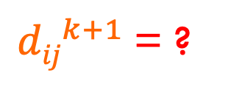
Recursive relationship
$dijk$ = shortest path from vertex $i$ to vertex $j$
using only vertices $\{1, 2, …, k\}$
Two options:
Vertex k+1 doesn’t give us a shorter path
Vertex k+1 does give us a shorter path
${dij}^{k+1}$= ?

Slide 14
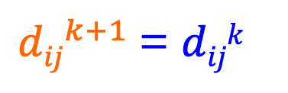
Recursive relationship
$dijk$ = shortest path from vertex $i$ to vertex $j$
using only vertices $\{1, 2, …, k\}$
Two options:
Vertex k+1 doesn’t give us a shorter path
Vertex k+1 does give us a shorter path
${dij}^{k+1}$= $dijk$

Slide 15
Recursive relationship
$dijk$ = shortest path from vertex $i$ to vertex $j$
using only vertices $\{1, 2, …, k\}$
Two options:
Vertex k+1 doesn’t give us a shorter path
Vertex k+1 does give us a shorter path
${dij}^{k+1}$= ?

Slide 16
Recursive relationship
$dijk$ = shortest path from vertex $i$ to vertex $j$
using only vertices $\{1, 2, …, k\}$
Two options:
Vertex k+1 doesn’t give us a shorter path
Vertex k+1 does give us a shorter path
${dij}^{k+1}$= ?
i
k+1
J
some vertices {1…k}
some vertices {1…k}
What is the cost of this path?

Slide 17
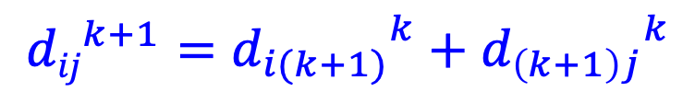
Recursive relationship
$dijk$ = shortest path from vertex $i$ to vertex $j$
using only vertices $\{1, 2, …, k\}$
Two options:
Vertex k+1 doesn’t give us a shorter path
Vertex k+1 does give us a shorter path
$${dij}^{k+1}={d_{i(k+1)}}^{k}+{d_{\left(k+1\right)j}}^{k}$$
i
k+1
J
some vertices {1…k}
some vertices {1…k}
d_{i(k+1)}^{k}
d_{(k+1)j}^{k}
+

Slide 18
Recursive relationship
$dijk$ = shortest path from vertex $i$ to vertex $j$
using only vertices $\{1, 2, …, k\}$
Two options:
Vertex k+1 doesn’t give us a shorter path
Vertex k+1 does give us a shorter path
${dij}^{k+1}$= ?
How do we combine these two options?

Slide 19
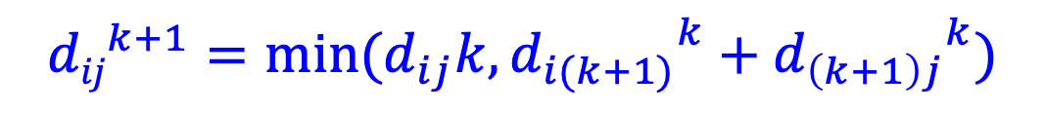
Recursive relationship
$dijk$ = shortest path from vertex $i$ to vertex $j$
using only vertices $\{1, 2, …, k\}$
Two options:
Vertex k+1 doesn’t give us a shorter path
Vertex k+1 does give us a shorter path
$${dij}^{k+1}={{min⁡(d_{ij}k,d}_{i(k+1)}}^{k}+{d_{\left(k+1\right)j}}^{k})$$
Pick whichever is shorter

Slide 20
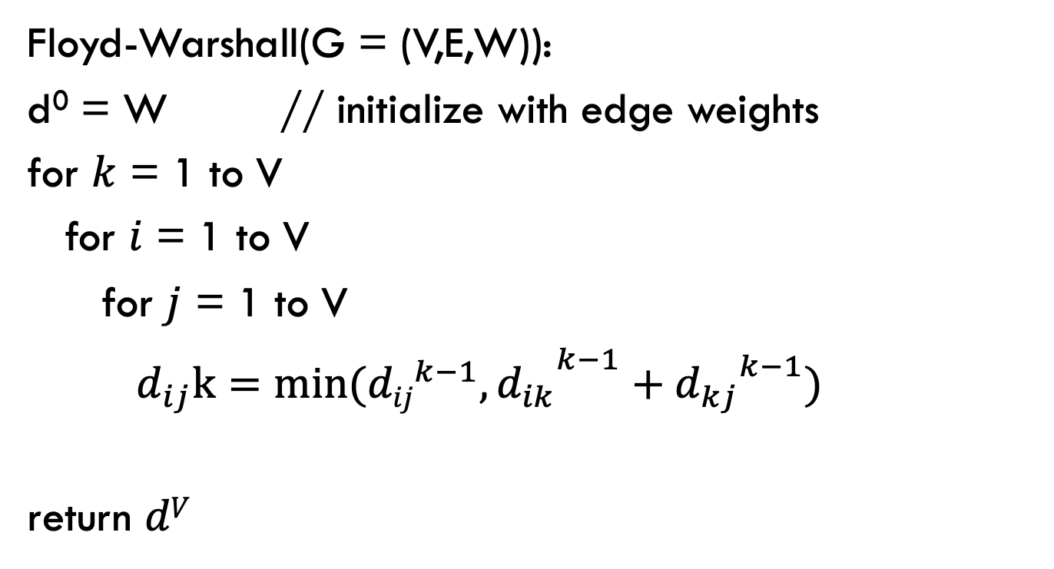
Floyd-Warshall
Calculate $dijk$ for increasing k, i.e., k = 1 to V
Floyd-Warshall(G = (V,E,W)):
d⁰ = W // initialize with edge weights
for $k$ = 1 to V
for $i$ = 1 to V
for $j$ = 1 to V
${{ d_{ij}k=min⁡({dij}^{k−1},d}_{ik}}^{k−1}+{d_{kj}}^{k−1})$
return $dV$

Slide 21
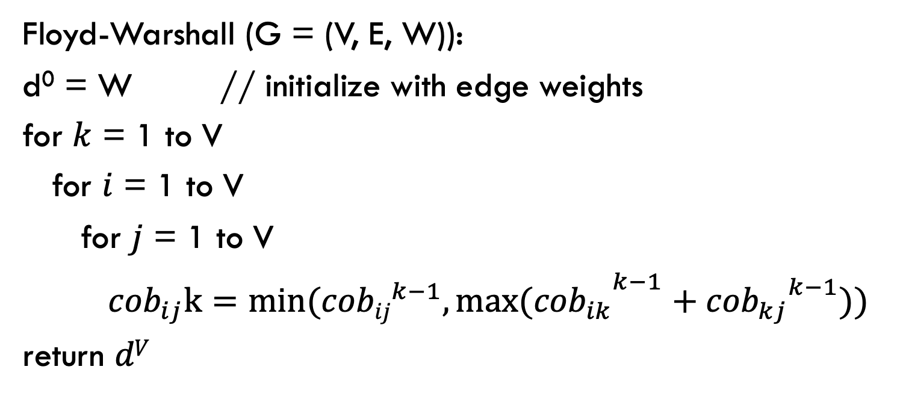
Floyd-Warshall (Coefficient of Boringness).
Calculate $dijk$ for increasing k, i.e. k = 1 to V
Floyd-Warshall (G = (V, E, W)):
d⁰ = W // initialize with edge weights
for $k$ = 1 to V
for $i$ = 1 to V
for $j$ = 1 to V
${{ {cob}_{ij}k=min⁡({cobij}^{k−1},max⁡(cob}_{ik}}^{k−1}+{{cob}_{kj}}^{k−1}))$
return $dV$

Slide 22
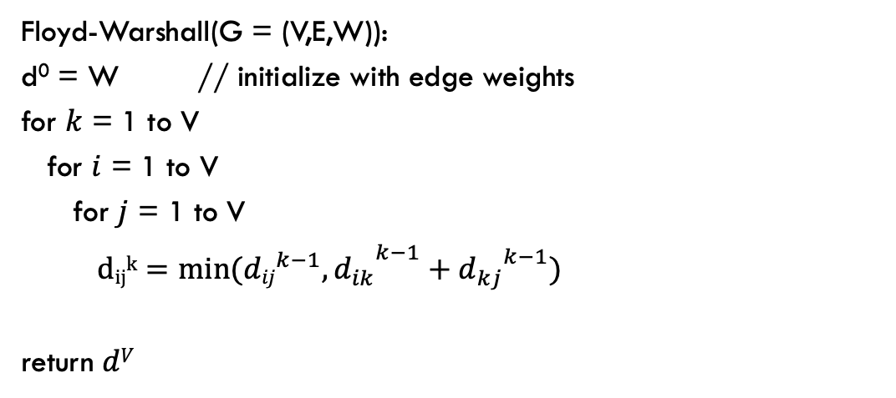
Floyd-Warshall(G = (V,E,W)):
d⁰ = W // initialize with edge weights
for $k$ = 1 to V
for $i$ = 1 to V
for $j$ = 1 to V
${{ dijk=min⁡({dij}^{k−1},d}_{ik}}^{k−1}+{d_{kj}}^{k−1})$
return $dV$
2
3
4
-1
1
3
-3
1
2
4
2
5
5
k = 0
k = 1
1 2 3 4 5
1 2 3 4 5
1
1
2
2
3
3
4
4
5
5
adjacency matrix
no change

Slide 23
Floyd-Warshall(G = (V,E,W)):
d⁰ = W // initialize with edge weights
for $k$ = 1 to V
for $i$ = 1 to V
for $j$ = 1 to V
${{ dijk=min⁡({dij}^{k−1},d}_{ik}}^{k−1}+{d_{kj}}^{k−1})$
return $dV$
2
3
4
-1
1
3
-3
1
2
4
2
5
5
k = 1
k = 2
1 2 3 4 5
1 2 3 4 5
1
1
2
2
3
3
4
4
5
5

Slide 24
Floyd-Warshall(G = (V,E,W)):
d⁰ = W // initialize with edge weights
for $k$ = 1 to V
for $i$ = 1 to V
for $j$ = 1 to V
${{ dijk=min⁡({dij}^{k−1},d}_{ik}}^{k−1}+{d_{kj}}^{k−1})$
return $dV$
2
3
4
-1
1
3
-3
1
2
4
2
5
5
k = 1
k = 2
1 2 3 4 5
1 2 3 4 5
1
1
2
2
3
3
4
4
5
5
minimum

Slide 25
Floyd-Warshall(G = (V,E,W)):
d⁰ = W // initialize with edge weights
for $k$ = 1 to V
for $i$ = 1 to V
for $j$ = 1 to V
${{ dijk=min⁡({dij}^{k−1},d}_{ik}}^{k−1}+{d_{kj}}^{k−1})$
return $dV$
2
3
4
-1
1
3
-3
1
2
4
2
5
5
k = 2
k = 3
1 2 3 4 5
1 2 3 4 5
1
1
2
2
3
3
4
4
5
5

Slide 26
Floyd-Warshall(G = (V,E,W)):
d⁰ = W // initialize with edge weights
for $k$ = 1 to V
for $i$ = 1 to V
for $j$ = 1 to V
${{ dijk=min⁡({dij}^{k−1},d}_{ik}}^{k−1}+{d_{kj}}^{k−1})$
return $dV$
2
3
4
-1
1
3
-3
1
2
4
2
5
5
k = 2
k = 3
1 2 3 4 5
1 2 3 4 5
1
1
2
2
3
3
4
4
5
5
minimum
Found a shorter path!

Slide 27
Floyd-Warshall(G = (V,E,W)):
d⁰ = W // initialize with edge weights
for $k$ = 1 to V
for $i$ = 1 to V
for $j$ = 1 to V
${{ dijk=min⁡({dij}^{k−1},d}_{ik}}^{k−1}+{d_{kj}}^{k−1})$
return $dV$
2
3
4
-1
1
3
-3
1
2
4
2
5
5
k = 2
k = 3
1 2 3 4 5
1 2 3 4 5
1
1
2
2
3
3
4
4
5
5

Slide 28
Floyd-Warshall(G = (V,E,W)):
d⁰ = W // initialize with edge weights
for $k$ = 1 to V
for $i$ = 1 to V
for $j$ = 1 to V
${{ dijk=min⁡({dij}^{k−1},d}_{ik}}^{k−1}+{d_{kj}}^{k−1})$
return $dV$
2
3
4
-1
1
3
-3
1
2
4
2
5
5
k = 2
k = 3
1 2 3 4 5
1 2 3 4 5
1
1
2
2
3
3
4
4
5
5

Slide 29
Floyd-Warshall(G = (V,E,W)):
d⁰ = W // initialize with edge weights
for $k$ = 1 to V
for $i$ = 1 to V
for $j$ = 1 to V
${{ dijk=min⁡({dij}^{k−1},d}_{ik}}^{k−1}+{d_{kj}}^{k−1})$
return $dV$
2
3
4
-1
1
3
-3
1
2
4
2
5
5
k = 2
k = 3
1 2 3 4 5
1 2 3 4 5
1
1
2
2
3
3
4
4
5
5
minimum

Slide 30
Floyd-Warshall(G = (V,E,W)):
d⁰ = W // initialize with edge weights
for $k$ = 1 to V
for $i$ = 1 to V
for $j$ = 1 to V
${{ dijk=min⁡({dij}^{k−1},d}_{ik}}^{k−1}+{d_{kj}}^{k−1})$
return $dV$
2
3
4
-1
1
3
-3
1
2
4
2
5
5
k = 2
k = 3
1 2 3 4 5
1 2 3 4 5
1
1
2
2
3
3
4
4
5
5

Slide 31
Floyd-Warshall(G = (V,E,W)):
d⁰ = W // initialize with edge weights
for $k$ = 1 to V
for $i$ = 1 to V
for $j$ = 1 to V
${{ dijk=min⁡({dij}^{k−1},d}_{ik}}^{k−1}+{d_{kj}}^{k−1})$
return $dV$
2
3
4
-1
1
3
-3
1
2
4
2
5
5
k = 2
k = 3
1 2 3 4 5
1 2 3 4 5
1
1
2
2
3
3
4
4
5
5

Slide 32
Floyd-Warshall(G = (V,E,W)):
d⁰ = W // initialize with edge weights
for $k$ = 1 to V
for $i$ = 1 to V
for $j$ = 1 to V
${{ dijk=min⁡({dij}^{k−1},d}_{ik}}^{k−1}+{d_{kj}}^{k−1})$
return $dV$
2
3
4
-1
1
3
-3
1
2
4
2
5
5
k = 2
k = 3
1 2 3 4 5
1 2 3 4 5
1
1
2
2
3
3
4
4
5
5
minimum
Found a shorter path!

Slide 33
Floyd-Warshall(G = (V,E,W)):
d⁰ = W // initialize with edge weights
for $k$ = 1 to V
for $i$ = 1 to V
for $j$ = 1 to V
${{ dijk=min⁡({dij}^{k−1},d}_{ik}}^{k−1}+{d_{kj}}^{k−1})$
return $dV$
2
3
4
-1
1
3
-3
1
2
4
2
5
5
k = 2
k = 3
1 2 3 4 5
1 2 3 4 5
1
1
2
2
3
3
4
4
5
5

Slide 34
Floyd-Warshall(G = (V,E,W)):
d⁰ = W // initialize with edge weights
for $k$ = 1 to V
for $i$ = 1 to V
for $j$ = 1 to V
${{ dijk=min⁡({dij}^{k−1},d}_{ik}}^{k−1}+{d_{kj}}^{k−1})$
return $dV$
2
3
4
-1
1
3
-3
1
2
4
2
5
5
k = 3
k = 4
1 2 3 4 5
1 2 3 4 5
1
1
2
2
3
3
4
4
5
5

Slide 35
Floyd-Warshall(G = (V,E,W)):
d⁰ = W // initialize with edge weights
for $k$ = 1 to V
for $i$ = 1 to V
for $j$ = 1 to V
${{ dijk=min⁡({dij}^{k−1},d}_{ik}}^{k−1}+{d_{kj}}^{k−1})$
return $dV$
2
3
4
-1
1
3
-3
1
2
4
2
5
5
k = 3
k = 4
1 2 3 4 5
1 2 3 4 5
1
1
2
2
3
3
4
4
5
5
minimum
Found a shorter path!

Slide 36
Floyd-Warshall(G = (V,E,W)):
d⁰ = W // initialize with edge weights
for $k$ = 1 to V
for $i$ = 1 to V
for $j$ = 1 to V
${{ dijk=min⁡({dij}^{k−1},d}_{ik}}^{k−1}+{d_{kj}}^{k−1})$
return $dV$
2
3
4
-1
1
3
-3
1
2
4
2
5
5
k = 3
k = 4
1 2 3 4 5
1 2 3 4 5
1
1
2
2
3
3
4
4
5
5

Slide 37
Floyd-Warshall(G = (V,E,W)):
d⁰ = W // initialize with edge weights
for $k$ = 1 to V
for $i$ = 1 to V
for $j$ = 1 to V
${{ dijk=min⁡({dij}^{k−1},d}_{ik}}^{k−1}+{d_{kj}}^{k−1})$
return $dV$
2
3
4
-1
1
3
-3
1
2
4
2
5
5
k = 3
k = 4
1 2 3 4 5
1 2 3 4 5
1
1
2
2
3
3
4
4
5
5

Slide 38
Floyd-Warshall(G = (V,E,W)):
d⁰ = W // initialize with edge weights
for $k$ = 1 to V
for $i$ = 1 to V
for $j$ = 1 to V
${{ dijk=min⁡({dij}^{k−1},d}_{ik}}^{k−1}+{d_{kj}}^{k−1})$
return $dV$
2
3
4
-1
1
3
-3
1
2
4
2
5
5
k = 3
k = 4
1 2 3 4 5
1 2 3 4 5
1
1
2
2
3
3
4
4
5
5
minimum
Found a shorter path!

Slide 39
Floyd-Warshall(G = (V,E,W)):
d⁰ = W // initialize with edge weights
for $k$ = 1 to V
for $i$ = 1 to V
for $j$ = 1 to V
${{ dijk=min⁡({dij}^{k−1},d}_{ik}}^{k−1}+{d_{kj}}^{k−1})$
return $dV$
2
3
4
-1
1
3
-3
1
2
4
2
5
5
k = 3
k = 4
1 2 3 4 5
1 2 3 4 5
1
1
2
2
3
3
4
4
5
5

Slide 40
Floyd-Warshall(G = (V,E,W)):
d⁰ = W // initialize with edge weights
for $k$ = 1 to V
for $i$ = 1 to V
for $j$ = 1 to V
${{ dijk=min⁡({dij}^{k−1},d}_{ik}}^{k−1}+{d_{kj}}^{k−1})$
return $dV$
2
3
4
-1
1
3
-3
1
2
4
2
5
5
k = 4
k = 5
1 2 3 4 5
1 2 3 4 5
1
1
2
2
3
3
4
4
5
5
Done!

Slide 41
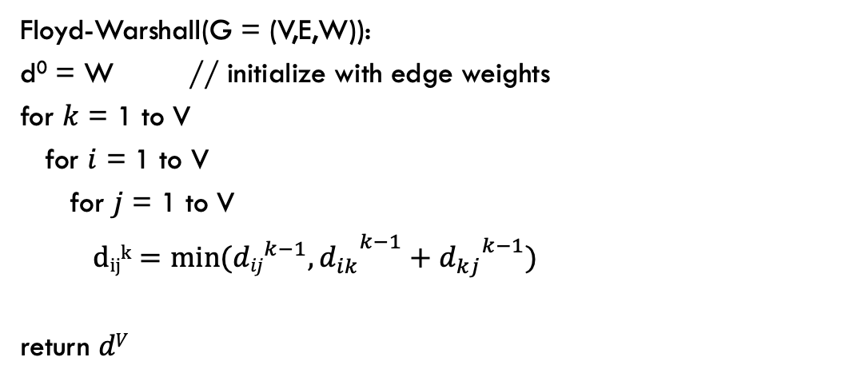
Floyd-Warshall analysis
Is it correct?
Floyd-Warshall(G = (V,E,W)):
d⁰ = W // initialize with edge weights
for $k$ = 1 to V
for $i$ = 1 to V
for $j$ = 1 to V
${{ dijk=min⁡({dij}^{k−1},d}_{ik}}^{k−1}+{d_{kj}}^{k−1})$
return $dV$

Slide 42
Floyd-Warshall analysis
Is it correct?
Any assumptions?
Floyd-Warshall(G = (V,E,W)):
d⁰ = W // initialize with edge weights
for $k$ = 1 to V
for $i$ = 1 to V
for $j$ = 1 to V
${{ dijk=min⁡({dij}^{k−1},d}_{ik}}^{k−1}+{d_{kj}}^{k−1})$
return $dV$

Slide 43
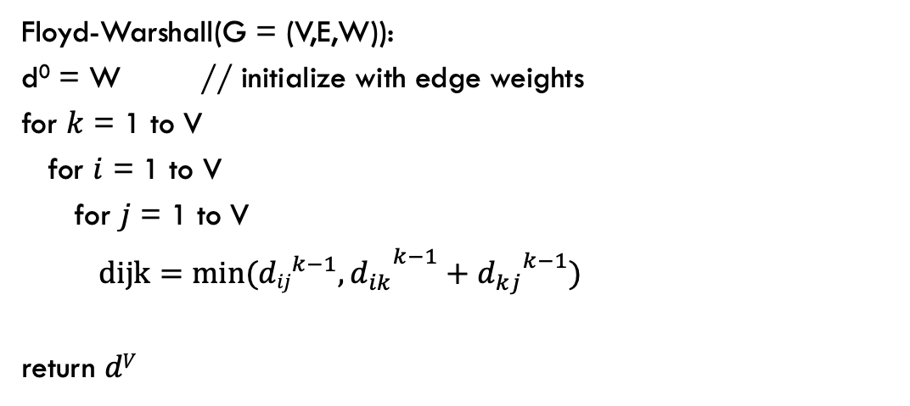
Floyd-Warshall analysis
Is it correct?
Assuming the graph has no negative cycles!
What happens if there is a negative cycle?
Floyd-Warshall(G = (V,E,W)):
d⁰ = W // initialize with edge weights
for $k$ = 1 to V
for $i$ = 1 to V
for $j$ = 1 to V
${{ dijk=min⁡({dij}^{k−1},d}_{ik}}^{k−1}+{d_{kj}}^{k−1})$
return $dV$

Slide 44
Floyd-Warshall analysis
If the graph has a negative weight cycle, at the end, at least one of the diagonal entries will be a negative number, i.e., we there’s a way to get back to a vertex using all the vertices that results in a negative weight.
1 2 3 4 5
1
2
3
4
5

Slide 45
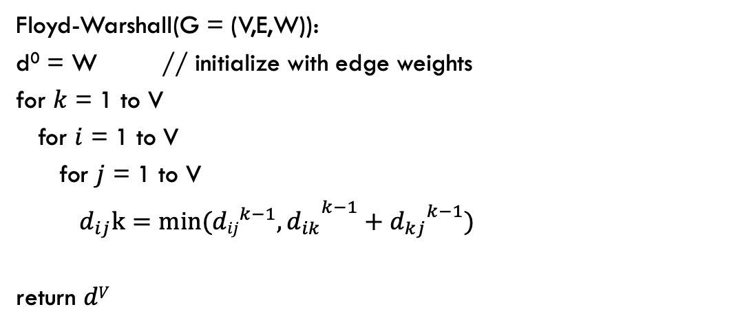
Floyd-Warshall analysis
Run-time?
Floyd-Warshall(G = (V,E,W)):
d⁰ = W // initialize with edge weights
for $k$ = 1 to V
for $i$ = 1 to V
for $j$ = 1 to V
${{ d_{ij}k=min⁡({dij}^{k−1},d}_{ik}}^{k−1}+{d_{kj}}^{k−1})$
return $dV$

Slide 46
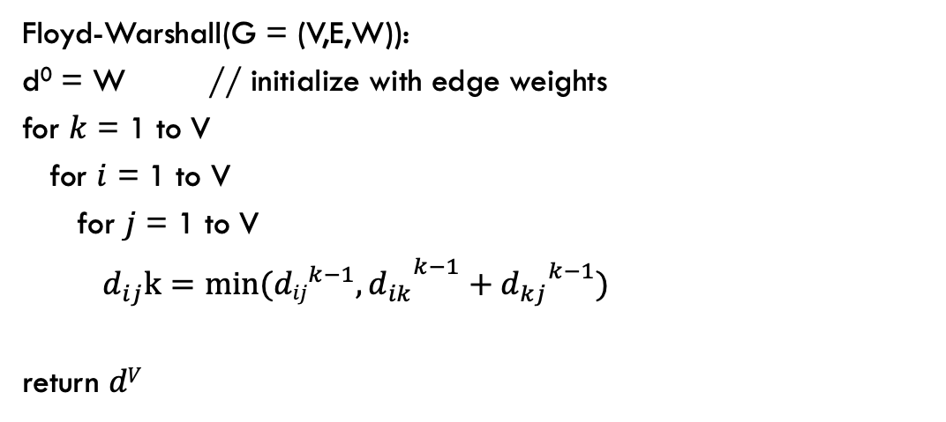
Floyd-Warshall analysis
Floyd-Warshall analysis
Run-time: θ(V³)
Floyd-Warshall(G = (V,E,W)):
d⁰ = W // initialize with edge weights
for $k$ = 1 to V
for $i$ = 1 to V
for $j$ = 1 to V
${{ d_{ij}k=min⁡({dij}^{k−1},d}_{ik}}^{k−1}+{d_{kj}}^{k−1})$
return $dV$

Slide 47
Floyd-Warshall analysis
Floyd-Warshall analysis
What type of algorithm is Floyd-Warshall?
Floyd-Warshall(G = (V,E,W)):
d⁰ = W // initialize with edge weights
for $k$ = 1 to V
for $i$ = 1 to V
for $j$ = 1 to V
${{ d_{ij}k=min⁡({dij}^{k−1},d}_{ik}}^{k−1}+{d_{kj}}^{k−1})$
return $dV$

Slide 48
Floyd-Warshall analysis
Floyd-Warshall analysis
Dynamic programming!!
Build up solutions to larger problems using solutions to smaller problems. Use a table to store the values.
Floyd-Warshall(G = (V,E,W)):
d⁰ = W // initialize with edge weights
for $k$ = 1 to V
for $i$ = 1 to V
for $j$ = 1 to V
${{ d_{ij}k=min⁡({dij}^{k−1},d}_{ik}}^{k−1}+{d_{kj}}^{k−1})$
return $dV$

Slide 49
Floyd-Warshall analysis
Floyd-Warshall analysis
Space usage?
Floyd-Warshall(G = (V,E,W)):
d⁰ = W // initialize with edge weights
for $k$ = 1 to V
for $i$ = 1 to V
for $j$ = 1 to V
${{ d_{ij}k=min⁡({dij}^{k−1},d}_{ik}}^{k−1}+{d_{kj}}^{k−1})$
return $dV$

Slide 50

Floyd-Warshall: key idea
Label all vertices with a number from 1 to V
$dijk$ = shortest path from vertex $i$ to vertex $j$
using only vertices $\{1, 2, …, k\}$
If we want all possibilities, how many values are there (i.e., what is the size of $dijk$)?

Slide 51
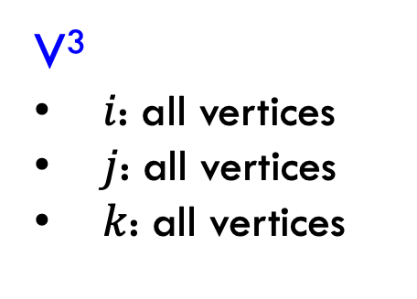
Floyd-Warshall: key idea
Label all vertices with a number from 1 to V
$dijk$ = shortest path from vertex $i$ to vertex $j$
using only vertices $\{1, 2, …, k\}$
V³
$i$: all vertices
$j$: all vertices
$k$: all vertices
Can we do better?

Slide 52
Floyd-Warshall analysis
Floyd-Warshall analysis
Space usage: θ(V²)
Only need the current value and the previous.
Floyd-Warshall(G = (V,E,W)):
d⁰ = W // initialize with edge weights
for $k$ = 1 to V
for $i$ = 1 to V
for $j$ = 1 to V
${{ d_{ij}k=min⁡({dij}^{k−1},d}_{ik}}^{k−1}+{d_{kj}}^{k−1})$
return $dV$

Slide 53
All pairs shortest paths
V * Bellman-Ford: O(V²E)
Floyd-Warshall: θ(V³)

Slide 54
All pairs shortest paths
All pairs shortest paths for positive weight graphs: calculate the shortest paths between all points
Easy solution?

Slide 55
All pairs shortest paths
All pairs shortest paths for positive weight graphs: calculate the shortest paths between all points
Run Dijsktra’s from each vertex!
Running time (in terms of E and V)?

Slide 56
All pairs shortest paths
All pairs shortest paths for positive weight graphs: calculate the shortest paths between all points
Run Dijsktras from each vertex!
O(V² log V + V E)
V calls to Dijkstras
Dijkstras: O(V log V + E)

Slide 57
All pairs shortest paths
V * Bellman-Ford: O(V²E)
Floyd-Warshall: θ(V³)
V * Dijkstras: O(V² log V + V E)
Is this any better?

Slide 58
All pairs shortest paths
V * Bellman-Ford: O(V²E)
Floyd-Warshall: θ(V³)
V * Dijkstras: O(V² log V + V E)
If the graph is sparse!

Slide 59
All pairs shortest paths
All pairs shortest paths for positive weight graphs: calculate the shortest paths between all points
Run Dijkstra’s from each vertex!
Challenge: Dijkstra’s assumes positive weights

Slide 60
Johnson’s: key idea
Reweight the graph to make all edges positive such that shortest paths are preserved.
0
2
B
D
B
D
1
-1
0
1
1
0
3
-3
A
3
A
2
4
C
E
4
C
E
8
5
What’s the shortest path from A to D?

Slide 61
Lemma
let h be any function mapping a vertex to a real value.
If we change the graph weights as:
The shortest paths are preserved.
Notes:
CLRS has proof

Slide 62
Lemma: proof
Let s, v₁, v₂, …, v_{k}, t be a path from s to t
The weight in the reweighted graph is:
weight for first edge
weight for remaining edges

Slide 63
Lemma: proof
Let s, v₁, v₂, …, v_{k}, t be a path from s to t
The weight in the reweighted graph is:
weight for remaining edges
weight for first edge
weight for second edge

Slide 64
Lemma: proof
Let s, v₁, v₂, …, v_{k}, t be a path from s to t
The weight in the reweighted graph is:

Slide 65
Lemma: proof
Let s, v₁, v₂, …, v_{k}, t be a path from s to t
The weight in the reweighted graph is:
weight for remaining edges
weight for third edge

Slide 66
Lemma: proof
Let s, v₁, v₂, …, v_{k}, t be a path from s to t
The weight in the reweighted graph is:
…

Slide 67
Lemma: proof
Claim: the weight change preserves shortest paths, i.e., if a path was the shortest from s to t in the original graph it will still be the shortest path from s to t in the new graph.
Justification?

Slide 68
Lemma: proof
Claim: the weight change preserves shortest paths, i.e., if a path was the shortest from s to t in the original graph it will still be the shortest path from s to t in the new graph.
h(s) – h(t) is a constant and will be the same for all paths from s to t, so the absolute ordering of all paths from s to t will not change.

Slide 69
Lemma
let h be any function mapping a vertex to a real value
If we change the graph weights as:
The shortest paths are preserved.
Big question: how do we pick h?
Notes:
CLRS has proof

Slide 70
Selecting h
Need to pick h such that the resulting graph has all weights as positive.
0
2
B
D
B
D
1
-1
0
1
1
0
3
-3
A
3
A
2
4
C
E
4
C
E
8
5

Slide 71
Johnson’s algorithm
Create G’ with one extra node s with 0 weight edges to all nodes run Bellman-Ford(G’, s).
if no negative-weight cycle:
reweight edges in G with h(v)=shortest path from s to v
run Dijkstra’s from every vertex
reweight shortest paths based on G

Slide 72
Create G’
run Bellman-Ford(G’,s)
if no negative-weight cycle
reweight edges in G with h(v)=shortest path from s to v
run Dijkstra’s from every vertex
reweight shortest paths based on G
S
0
0
0
0
2
B
D
0
2
-1
B
D
-1
1
3
-3
1
A
2
3
-3
A
2
4
C
E
4
C
E
5
5

Slide 73
Create G’
run Bellman-Ford(G’,s)
if no negative-weight cycle
reweight edges in G with h(v)=shortest path from s to v
run Dijkstra’s from every vertex
reweight shortest paths based on G
S
0
0
S➔A: ?
S➔B:
S➔C:
S➔D:
S➔E:
0
0
0
2
B
D
-1
1
3
-3
A
2
4
C
E
5

Slide 74
Create G’
run Bellman-Ford(G’,s)
if no negative-weight cycle
reweight edges in G with h(v)=shortest path from s to v
run Dijkstra’s from every vertex
reweight shortest paths based on G
S
0
0
S➔A: 0
S➔B:
S➔C:
S➔D:
S➔E:
0
0
0
2
B
D
-1
1
3
-3
A
2
4
C
E
5

Slide 75
Create G’
run Bellman-Ford(G’,s)
if no negative-weight cycle
reweight edges in G with h(v)=shortest path from s to v
run Dijkstra’s from every vertex
reweight shortest paths based on G
S
0
0
S➔A: 0
S➔B: ?
S➔C:
S➔D:
S➔E:
0
0
0
2
B
D
-1
1
3
-3
A
2
4
C
E
5

Slide 76
Create G’
run Bellman-Ford(G’,s)
if no negative-weight cycle
reweight edges in G with h(v)=shortest path from s to v
run Dijkstra’s from every vertex
reweight shortest paths based on G
S
0
0
S➔A: 0
S➔B: -2
S➔C:
S➔D:
S➔E:
0
0
0
2
B
D
-1
1
3
-3
A
2
4
C
E
5

Slide 77
Create G’
run Bellman-Ford(G’,s)
if no negative-weight cycle
reweight edges in G with h(v)=shortest path from s to v
run Dijkstra’s from every vertex
reweight shortest paths based on G
S
0
0
S➔A: 0
S➔B: -2
S➔C: 0
S➔D: 0
S➔E: -3
0
0
0
2
B
D
-1
1
3
-3
A
2
4
C
E
5

Slide 78
S➔A: 0
S➔B: -2
S➔C: 0
S➔D: 0
S➔E: -3
-2
0
2
B
D
-1
0
1
3
-3
A
2
4
C
E
5
-3
0

Slide 79
Create G’
run Bellman-Ford(G’,s)
if no negative-weight cycle
reweight edges in G with h(v)=shortest path from s to v
run Dijkstra’s from every vertex
reweight shortest paths based on G
-2
0
2
B
D
B
D
-1
?
0
1
3
-3
A
A
2
4
C
E
C
E
5
-3
0
h(v) in blue

Slide 80
Create G’
run Bellman-Ford(G’,s)
if no negative-weight cycle
reweight edges in G with h(v)=shortest path from s to v
run Dijkstra’s from every vertex
reweight shortest paths based on G
-1 + 0 - -2
-2
0
2
B
D
B
D
-1
1
0
1
3
-3
A
A
2
4
C
E
C
E
5
-3
0
h(v) in blue

Slide 81
Create G’
run Bellman-Ford(G’,s)
if no negative-weight cycle
reweight edges in G with h(v)=shortest path from s to v
run Dijkstra’s from every vertex
reweight shortest paths based on G
-2
0
2
?
B
D
B
D
-1
1
0
1
3
-3
A
A
2
4
C
E
C
E
5
-3
0
h(v) in blue

Slide 82
Create G’
run Bellman-Ford(G’,s)
if no negative-weight cycle
reweight edges in G with h(v)=shortest path from s to v
run Dijkstra’s from every vertex
reweight shortest paths based on G
2 + -2 - 0
-2
0
2
0
B
D
B
D
-1
1
0
1
3
-3
A
A
2
4
C
E
C
E
5
-3
0
h(v) in blue

Slide 83
Create G’
run Bellman-Ford(G’,s)
if no negative-weight cycle
reweight edges in G with h(v)=shortest path from s to v
run Dijkstra’s from every vertex
reweight shortest paths based on G
-2
0
2
0
B
D
B
D
-1
1
0
1
3
-3
A
A
2
?
4
C
E
C
E
5
-3
0
h(v) in blue

Slide 84
Create G’
run Bellman-Ford(G’,s)
if no negative-weight cycle
reweight edges in G with h(v)=shortest path from s to v
run Dijkstra’s from every vertex
reweight shortest paths based on G
4 + 0 - 0
-2
0
2
0
B
D
B
D
-1
1
0
1
3
-3
A
A
2
4
4
C
E
C
E
5
-3
0
h(v) in blue

Slide 85
Create G’
run Bellman-Ford(G’,s)
if no negative-weight cycle
reweight edges in G with h(v)=shortest path from s to v
run Dijkstra’s from every vertex
reweight shortest paths based on G
-2
0
2
0
B
D
B
D
-1
1
0
1
3
-3
A
A
2
4
4
C
?
E
C
E
5
-3
0
h(v) in blue

Slide 86
Create G’
run Bellman-Ford(G’,s)
if no negative-weight cycle
reweight edges in G with h(v)=shortest path from s to v
run Dijkstra’s from every vertex
reweight shortest paths based on G
5 + 0 - -3
-2
0
2
0
B
D
B
D
-1
1
0
1
3
-3
A
A
2
4
4
C
8
E
C
E
5
-3
0
h(v) in blue

Slide 87
Create G’
run Bellman-Ford(G’,s)
if no negative-weight cycle
reweight edges in G with h(v)=shortest path from s to v
run Dijkstra’s from every vertex
reweight shortest paths based on G
-2
0
2
0
B
D
B
D
-1
1
0
1
0
3
-3
1
0
A
2
A
3
4
C
E
4
C
E
5
-3
8
0
h(v) in blue

Slide 88
Create G’
run Bellman-Ford(G’,s)
if no negative-weight cycle
reweight edges in G with h(v)=shortest path from s to v
run Dijkstra’s from every vertex
reweight shortest paths based on G
0
B
D
1
0
1
0
A
3
4
C
E
8

Slide 89
Create G’
run Bellman-Ford(G’,s)
if no negative-weight cycle
reweight edges in G with h(v)=shortest path from s to v
run Dijkstra’s from every vertex
reweight shortest paths based on G
0
B
D
1
1
0
A
C
E

Slide 90
Create G’
run Bellman-Ford(G’,s)
if no negative-weight cycle
reweight edges in G with h(v)=shortest path from s to v
run Dijkstra’s from every vertex
reweight shortest paths based on G
-2
0
2
2
B
D
B
D
-1
-1
0
1
3
-3
-3
A
2
A
3
4
C
E
C
E
5
-3
0

Slide 91
A➔B: -1
A➔C: 2
A➔D: 1
A➔E: -2
-2
0
2
2
B
D
B
D
-1
-1
0
1
3
-3
-3
A
2
A
3
4
C
E
C
E
5
-3
0

Slide 92
Selecting h
Need to pick h such that the resulting graph has all weights as positive.
Create G’ with one extra node s with 0 weight edges to all nodes
run Bellman-Ford(G’,s)
if no negative-weight cycle
reweight edges in G with h(v)=shortest path from s to v
run Dijkstra’s from every vertex
reweight shortest paths based on G
Why does this work (i.e., how do we guarantee that reweighted graph has only positive edges)?

Slide 93
Reweighted graph is positive
Take two nodes u and v
h(u) shortest distance from s to u
h(v) shortest distance from s to v
Claim:
Why?

Slide 94
Reweighted graph is positive
Take two nodes u and v
h(u) shortest distance from s to u
h(v) shortest distance from s to v
Claim:
If this weren’t true, we could have made a shorter path s to v using u
… but this is in contradiction with how we defined h(v)

Slide 95
Reweighted graph is positive
Take two nodes u and v
h(u) shortest distance from s to u
h(v) shortest distance from s to v
What is this?

Slide 96
Reweighted graph is positive
Take two nodes u and v
h(u) shortest distance from s to u
h(v) shortest distance from s to v
All edge weights in reweighted graph are non-negative

Slide 97
Johnson’s algorithm
Create G’
run Bellman-Ford(G’,s)
if no negative-weight cycle
reweight edges in G
run Dijkstra’s from every vertex
reweight shortest paths based on G
Run-time?

Slide 98
Johnson’s algorithm
Create G’
run Bellman-Ford(G’,s)
if no negative-weight cycle
reweight edges in G
run Dijkstra’s from every vertex
reweight shortest paths based on G
θ(V)
θ(VE)
θ(E)
O(V²logV+VE)
θ(E)
Run-time?

Slide 99
All pairs shortest paths
V * Bellman-Ford: O(V²E)
Floyd-Warshall: θ(V³)
Johnson’s: O(V² log V + V E)

Slide 100
Handout

Slide 101
What are the shortest paths from S to each of the vertices?
S
0
0
S➔A: ?
S➔B:
S➔C:
S➔D:
S➔E:
0
0
0
2
B
D
-1
1
3
-3
A
2
4
C
E
5

Slide 102
Reweight the graph on the right based on the h values
-2
0
2
B
D
B
D
-1
0
1
3
-3
A
A
2
4
C
E
C
E
5
-3
0
h(v) in blue

